Slide 1
Designing to the limits of your imagination!
Aluminum Extrusions
Brought to you by:
Aluminum Extruders Council
www.aec.org
ET Foundation
www.etfoundation.org
Revised November 8, 2014
Notes:
Hi – my name is _______. I am __(position)__ at ___(company)____
Today I’m here representing my company and our industry – aluminum extrusions.
I’m going to take this opportunity to tell you a bit about the amazing industrial process behind many commonly used products – aluminum extrusion and to tell you about a terrific design competition put on by the Aluminum Extruders Council and Hydro Aluminum under the ET Foundation, which has already paid out hundred’s of thousands of $ in cash awards.
Most of the slides are self explanatory, but I’ll help to add context as we progress through the presentation.

Slide 2
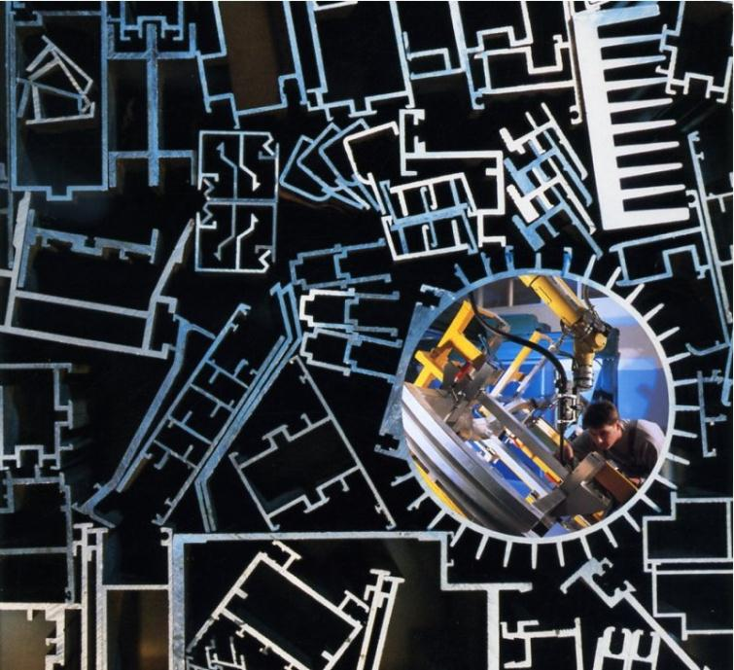
Courtesy of Light Metal Age magazine
Notes:
Extrusions come in an almost infinite variety of shapes, filling almost an infinite variety of requirements

Slide 3
Extrusion: often the most cost effective and quickest path between concept and product
The aluminum extrusion process is incredibly versatile and capable of converting ideas to reality quickly, accurately and inexpensively
Designers can utilize a near-net shape process to close tolerances, coupled with a list of superior physical characteristics to optimize their designs
This presentation provides both a conceptual and a practical understanding of how best to design with aluminum extrusions
Courtesy of Light Metal Age magazine

Slide 4
Extrusion: often the quickest path between concept and product
Aluminum extrusions offer a long list of advantages – both those inherent in aluminum as well as those gained from the extrusion process
Combining aluminum and the extrusion process: yields results which are second-to-none regarding form, fit, function, appearance and cost, producing amazing, attractive parts and advantages
Aluminum extrusions are green, providing strong, lightweight designs which are fully recylable

Slide 5
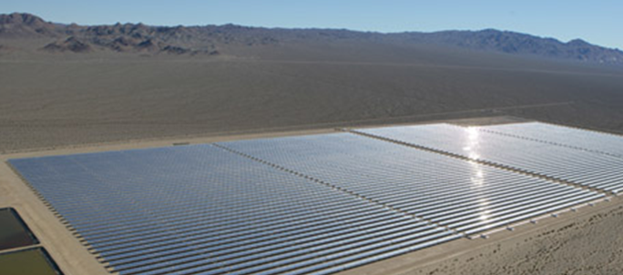
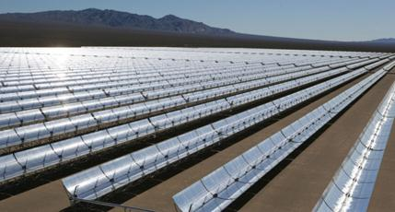
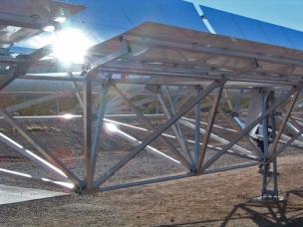
Example of Aluminum Extrusions used in Nevada Solar One Concentrated Solar Power Plant
Notes:
Nevada Solar one began operations a few years ago. It is a 64 megawatt solar field concentrating the sun’s energy via parabolic mirrors onto collection tubes containing thermal oil. This oil is heated to almost 800 d.F., and is piped to a central conventional steam turbine plant, which runs generators to produce electricity.
The almost 8 million lbs of aluminum extrusions for the framework supporting these parabolic mirror frames were produced by Hydro Aluminum in their Phoenix, AZ facility.

Slide 6
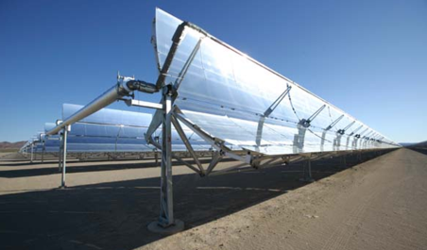
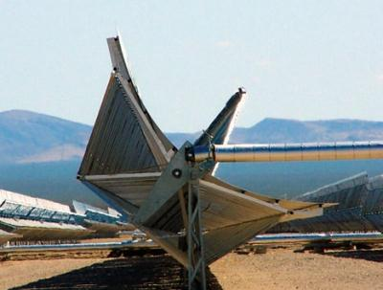
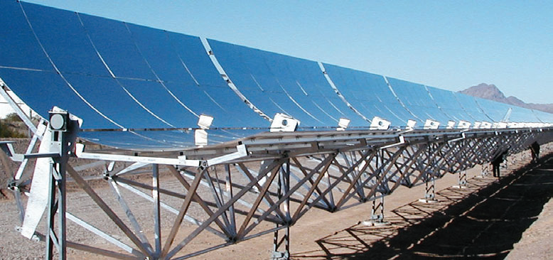
Aluminum Extrusions are strong and efficient; creating long lasting structures, critical to our future
Photos By Gossamer Space Frames. Used By Permission of Acciona Solar Power
Notes:
The strength and lightweight nature of aluminum extrusions, coupled with the ability to design custom, integral shapes, leading to ease of fabrication and assembly made aluminum extrusions an IDEAL solution for this product.

Slide 7
Aluminum Extrusion Design Competition
www.etfoundation.org
www.aec.org
Design, Architect, and Engineering Students:
Apply what you've learned about design and engineering by entering the International Aluminum Extrusion Design Competition. It's an excellent opportunity for a hands-on learning experience with the potential for professional recognition and earned scholarships.
Student Class Scholarship Awards
Enter the competition to receive the recognition you so richly deserve; gain pride and a sense of accomplishment. And, of course, there are the scholarships totaling $8,500!
Student Class Scholarships:
1st place $3000
2nd place $2000
3rd place $1000
Sapa Sustainable Design: $2,500
Entry Deadline: March 30, 2015
Notes:
AT THE END OF THIS PRESENTATION, THERE WILL BE SOME KEY INFORMATION ABOUT THE ALUMINUM EXTRUSION ANNUAL DESIGN COMPETITION WHICH MAY BE OF GREAT FINANCIAL INTEREST TO YOU ALL

Slide 8
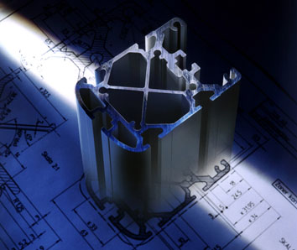
Ideas taking shape
An idea takes shape in the designer’s mind and then takes shape as a final product
Through the flexibility of the aluminum extrusion process, profiles can be creatively fine-tuned to specifically fit the design requirements or to be specifically branded with your details
All thanks to the amazing versatility of aluminum extrusion

Slide 9
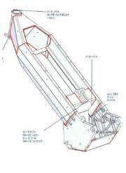
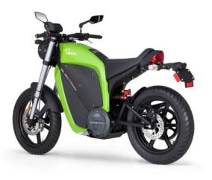
The Shape is the Idea
Almost any shape can be produced through aluminum extrusion
The highly workable material can create a shape that can then be enhanced and perfected through additional machining, finishing and fabrication
2008 Transportation Category Winner
Electric motorcycle frame
Photo courtesy of BRAMMO
BRAMMO Enertia Electric Motorcycle
Notes:
Many common products are made with aluminum extrusions. The combination of versatility, light weight and strength makes this material and process ideal for the most demanding applications.

Slide 10
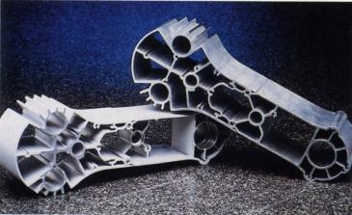
The Shape becomes more than an end in itself
The Shape can be designed and extruded to be more than the base for a useful product.
It can be formed to:
Reduce piece count / provide complex integral features
Facilitate manufacturing and assembly
Reduce costs and lead times for materials and production
Increase product reliability and durability
Simplify maintenance and repairs for the final user of the product
“Build in” an attractive appearance that can make the product easier to sell
Courtesy of Light Metal Age magazine
Notes:
This robotic arm extrusion shows how the extrusion process can integrate many critical features, allowing the designer to incorporate features that in other processes would require machining or fabrication and assembly of additional pieces to accomplish. THE CAPABILITY OF ALUMINUM EXTRUSIONS TO PROVIDE NEAR NET SHAPE PRODUCTS WITH INTEGRATED, COMPLEX FEATURES IS UNPATROLLED BY MOST OTHER MANUFACTURING PROCESSES!

Slide 11
Consider the Advantages:
From simple household appliances to exotic space and electronics applications, products made from aluminum extrusions are superior in:
Design Flexibility
Performance
Efficiency
Reliability
Cost
Photo courtesy of NASA

Slide 12
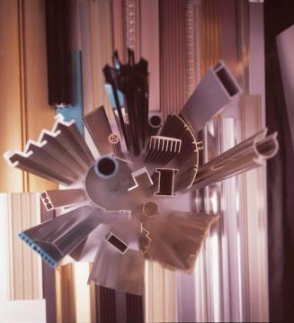
Aluminum extrusions remain the best choice for many applications
Advancing techniques in manufacturing and assembly can extend aluminum’s use to even more applications, including those in which other materials have long been employed.
The combination of the basic properties of aluminum and its alloys, plus the infinite variety of shapes possible in the extrusion process give aluminum extrusion its many advantages over other materials and methods of forming.
The aluminum extrusion process is flexible and has both extremely low tooling costs and short lead times, enabling efficient production of near net shape, complex integral parts – allowing exceptional reductions to part counts and subsequent fabrication and assembly

Slide 13
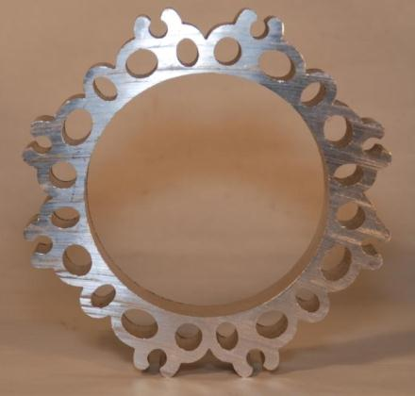
Advantages of Aluminum
Lightweight
Strong
High Strength-to-Weight Ratio
Resilient
Corrosion-Resistant
Heat Conductive
Reflective
Electrically Conductive
Non-Magnetic
Non-Sparking
Non-Combustible
Cold Strength
Fully Recylcable
Courtesy of Werner Extruded Solutions LLC

Slide 14
Aluminum Extrusions can be produced in different alloys and processed to different tempers to achieve desired mechanical properties, corrosion resistance, machinability, formability and other attributes
Wrought Alloy Designation | Major Alloying Elements and Alloy Characteristics
1000 Series | Minimum 99% Aluminum High corrosion resistance. Excellent finishability. Easily joined by all methods. Low strength, poor machinability. Excellent workability. High electrical conductivity.
2000 Series | Copper High strength. Relatively low corrosion resistance. Excellent machinability. Heat treatable.
3000 Series | Manganese Low to medium strength. Good corrosion resistance. Poor machinability. Good workability.
4000 Series | Silicon Not available as extruded products
5000 Series | Magnesium Low to moderate strength. Excellent marine corrosion resistance. Very good weldability.
6000 Series | Magnesium & Silicon Most popular extrusion alloy class. Good strength. Good corrosion resistance. Good machinability. Good weldability. Good formability. Heat treatable.
7000 Series | Zinc Very high strength. Poor corrosion resistance. Good machinability. Heat treatable.
Typical Extrusion Tempers | Description
O | Fully annealed.
H112 | Strain-hardened; used for nonheat-treatable alloys.
T1 | Cooled from an elevated temperature and naturally aged.
T4 | Solution heat-treated and naturally aged.
T5 | Cooled from an elevated temperature and artificially aged.
T6 | Solution heat-treated and artificially aged

Slide 15
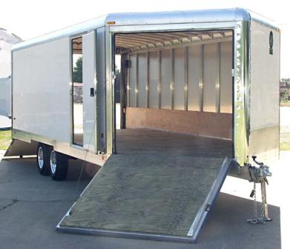
Advantages of Aluminum
Lightweight
Only about one-third as heavy as iron, steel, copper or brass. Thus, in applications where volume remains the same regardless of metal used, aluminum goes about three times as far as the other metals.
Strong
High Strength-to-Weight Ratio
Resilient
Corrosion-Resistant
Heat Conductive
Reflective
Electrically Conducive
Non-Magnetic
Non-Sparking
Non-Combustible
Cold Strength
Fully Recyclable
Photo courtesy of Classic Trailers, Inc.
Notes:
The strength, light weight and corrosion resistance of aluminum extrusions makes it a natural choice for demanding transportation applications such as this truck trailer.

Slide 16
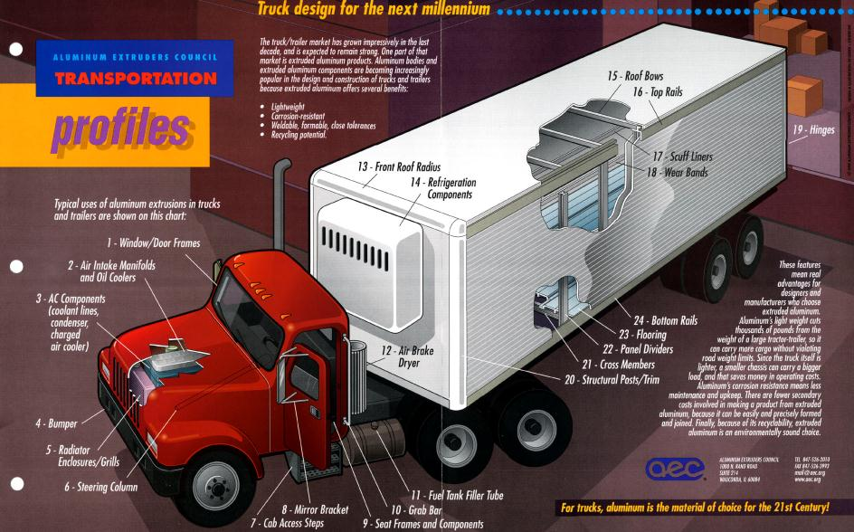
Strong, lightweight aluminum extrusions are used throughout the transportation market.
Notes:
Don’t spend a lot of time on this slide – just read the title and show it.

Slide 17
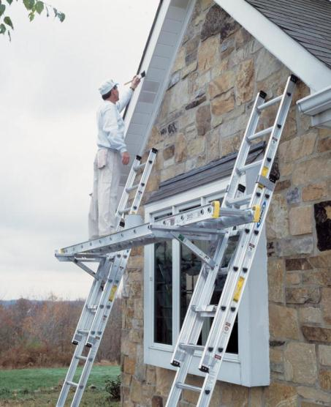
Advantages of Aluminum
Lightweight
Strong
Appropriately alloyed and treated, aluminum can be stronger than some steels, with ultimate tensile strengths as high as 80,000 psi to 90,000 psi or more.
High Strength-to-Weight Ratio
Resilient
Corrosion-Resistant
Heat Conductive
Reflective
Electrically Conduciive
Non-Magnetic
Non-Sparking
Non-Combustible
Cold Strength
Fully Recyclable
Courtesy of Werner Co.
Notes:
Besides the 60 ft ladder shown on the other slide, shorter aluminum extension ladders are regularly used every day by professionals and homeowners, both of whom rely on the strength of aluminum extrusions to keep them safe and let them work at heights

Slide 18
Advantages of Aluminum
Lightweight
Strong
Appropriately alloyed and treated, aluminum can be stronger than some steels, with ultimate tensile strengths as high as 80,000 psi to 90,000 psi or more.
High Strength-to-Weight Ratio
Resilient
Corrosion-Resistant
Heat Conductive
Reflective
Electrically Conductive
Non-Magnetic
Non-Sparking
Non-Combustible
Cold Strength
Fully Recyclable
Material | Modulus (E) (10⁶ psi)
Mild Steel | 29.0
Aluminum | 10.0
Brass | 13.0
Zinc | 13.0
Plastics:
PS | 0.51
PET | 0.29
Nylon | 0.42
Peek | 0.56
The modulus of elasticity (E) is the relationship of how the material deforms compared to the stress that it is under.
Notes:
While some specialty alloys can reach strengths of 90,000 psi, common 6000 series alloys in everyday use typically have a yield strength of 35,000 psi with an ultimate strength of 38,000 psi.

Slide 19
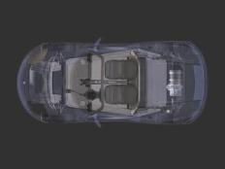
Advantages of Aluminum
Lightweight
Strong
High Strength-to-Weight Ratio
High strength plus low weight permits substantial reductions in the weight of both parts and final products
Resilient
Corrosion-Resistant
Heat Conductive
Reflective
Electrically Conductive
Non-Magnetic
Non-Sparking
Non-Combustible
Cold Strength
Fully Recyclable
Rendering and photo courtesy of Tesla Motors, Inc.
Notes:
Fuel economy is driven by aerodynamics and weight. The use of aluminum extrusions throughout cars creates a much lighter car.

Slide 20
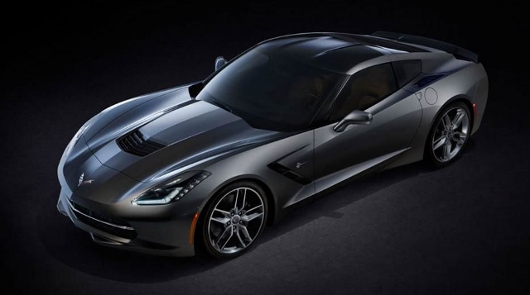
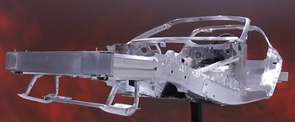
Strong, lightweight aluminum extrusions are used throughout the transportation market.
© General Motors http://www.chevrolet.com/new-2014-corvette/?seo=goo_|_GM+Chevy+Awareness_|_GG-AWR-Corvette-Stingray-BP-SN-Exact_|_Corvette+Stingray_|_2014%20corvette
Notes:
As with the earlier truck slide, strong, lightweight extrusions are used throughout the transportation market.

Slide 21
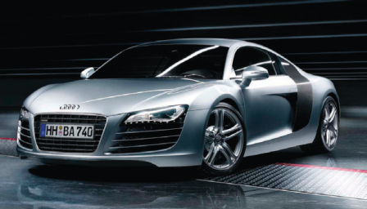
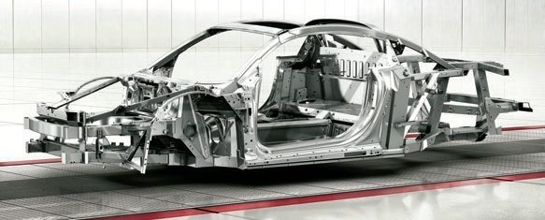
Advantages of Aluminum
High Strength-to-Weight Ratio
Rendering and photo courtesy of Audi USA
Notes:
While this photo and spaceframe are of Audi’s spectacular R8 sports car, aluminum automotive structures have been used for many years due to their light weight, strength, toughness and ability to be designed, fabricated and assembled in so many creative ways.
Aluminum step and extension ladders have relied on the outstanding characteristics of aluminum extrusions to offer cost effective, high strength, low weight products that are use every day by millions of people.

Slide 22
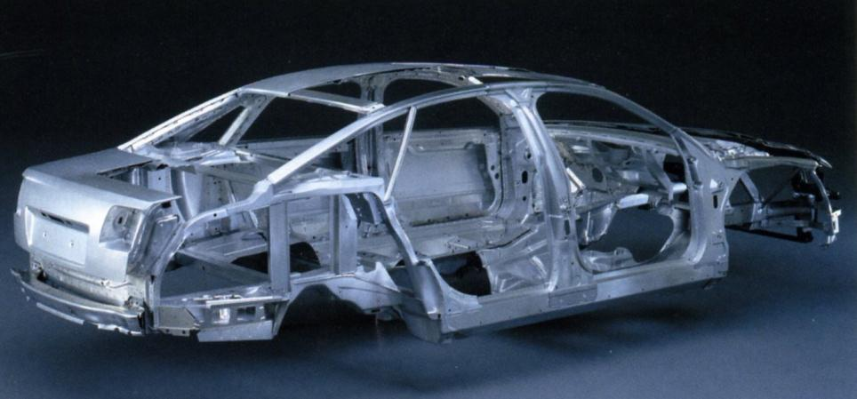
Audi A8 Extruded Aluminum Spaceframe
Courtesy of Light Metal Age magazine
Notes:
The Audi A8 has successfully used a spaceframe composed of extruded aluminum to achieve its excellent strength-to-weight ratio, resulting in exceptional performance (acceleration and cornering capabilities) and economy.

Slide 23
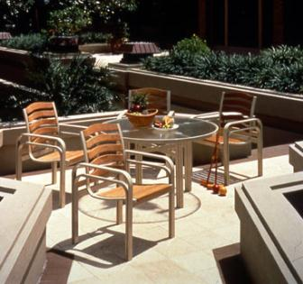
Advantages of Aluminum
Lightweight
Strong
High Strength-to-Weight Ratio
Resilient
Aluminum products can deflect under loads and shocks and spring right back
Corrosion-Resistant
Heat Conductive
Reflective
Electrically Conductive
Non-Magnetic
Non-Sparking
Non-Combustible
Cold Strength
Fully Recyclable
Notes:
Naturally, aluminum’s resistance to corrosion also adds to its benefits in application s such as outdoor furniture, architectural applications, ladders, etc…

Slide 24
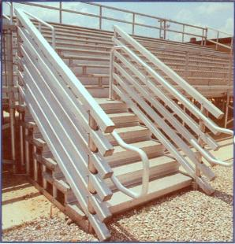
Advantages of Aluminum
Lightweight
Strong
High Strength-to-Weight Ratio
Resilient
Corrosion-Resistant
Excellent corrosion resistance in a wide variety of environments and contact with a myriad of substances. It develops its own inert aluminum oxide film, which is self-protective, blocking further oxidation
Heat Conductive
Reflective
Electrically Conductive
Non-Magnetic
Non-Sparking
Non-Combustible
Cold Strength
Fully Recyclable
Photo courtesy of Aluminum Chambered Boats, Inc.
Notes:
Aluminum is highly reactive with oxygen and instantly forms a thin, tenacious aluminum oxide coating protecting the underlying aluminum. Many iron or steel products also form an oxide coating, but it is often neither thin NOR tenacious – we typically call this “RUST” and it often leads to the degradation of products made with iron or steel.
Marine applications for aluminum extrusions take extensive advantage of the high strength-to-weight ratios and exceptional corrosion resistance of many commonly used aluminum alloys.

Slide 25
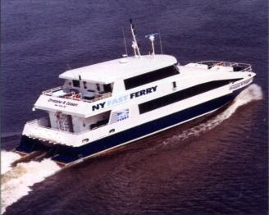
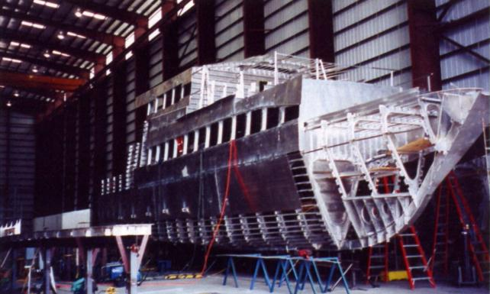
Advantages of Aluminum
Lightweight
Strong
High Strength-to-Weight Ratio
Resilient
Corrosion-Resistant
Heat Conductive
Reflective
Electrically Conductive
Non-Magnetic
Non-Sparking
Non-Combustible
Cold Strength
Fully Recyclable
Courtesy of Light Metal Age magazine
Notes:
Aluminum is highly reactive with oxygen and instantly forms a thin, tenacious aluminum oxide coating protecting the underlying aluminum. Many iron or steel products also form an oxide coating, but it is often neither thin NOR tenacious – we typically call this “RUST” and it often leads to the degradation of products made with iron or steel.
Marine applications for aluminum extrusions take extensive advantage of the high strength-to-weight ratios and exceptional corrosion resistance of many commonly used aluminum alloys.

Slide 26
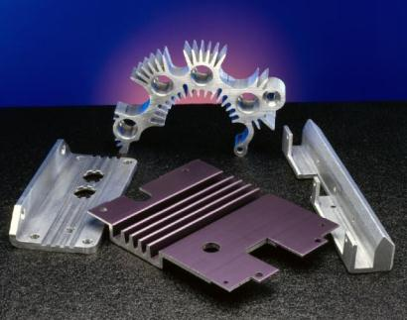
Advantages of Aluminum
Lightweight
Strong
High Strength-to-Weight Ratio
Resilient
Corrosion-Resistant
Heat Conductive
Conducts heat better than any other common metal on both a weight and cost basis.
Reflective
Electrically Conductive
Non-Magnetic
Non-Sparking
Non-Combustible
Cold Strength
Fully Recyclable
Courtesy of Werner Co.
Notes:
Aluminum extrusions are used throughout many industries for their heat conduction properties. Heat sinks take heat away from critical computer, electronic or other sources of heat, and extrusions are used to ADD heat as well

Slide 27
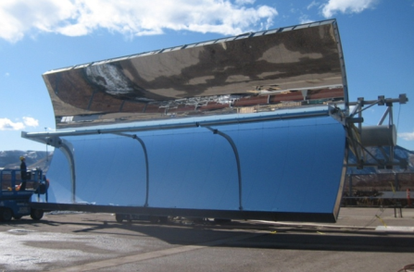
Advantages of Aluminum
Lightweight
Strong
High Strength-to-Weight Ratio
Resilient
Corrosion-Resistant
Heat Conductive
Reflective
Highly reflective (more than 80 percent) of both visible light and the invisible radiation beyond both ends of the visible spectrum
Electrically Conductive
Non-Magnetic
Non-Sparking
Non-Combustible
Cold Strength
Fully Recyclable
Courtesy of Alcoa
Notes:
The exceptional surface finish of some alloys (6463 for example) coupled with mechanical finishing such as polishing and anodizing, creates exceptionally beautiful extrusions, used for both decorative and practical applications (such as lighting fixtures).

Slide 28
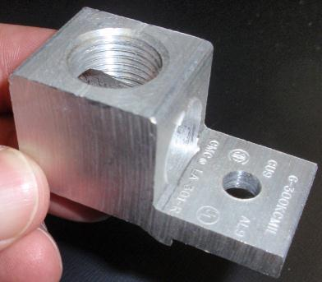
Advantages of Aluminum
Lightweight
Strong
High Strength-to-Weight Ratio
Resilient
Corrosion-Resistant
Heat Conductive
Reflective
Electrically Conductive
Volume for volume, aluminum carries electricity about 62% as well as copper. On an equal weight basis, aluminum can be twice as conductive as copper, and aluminum is often the most economical choice.
Non-Magnetic
Non-Sparking
Non-Combustible
Cold Strength
Fully Recyclable
Courtesy of Werner Extruded Solutions LLC
Notes:
The photo shows an electrical lug which is used in electrical panels. The part is drilled and tapped and used to connect wires together. These types of parts are available in a great variety of sizes.
Bus bar systems providing electricity throughout large manufacturing operations make extensive use of aluminum extrusions for their exceptional ability to conduct electricity with low losses and heat generation.

Slide 29
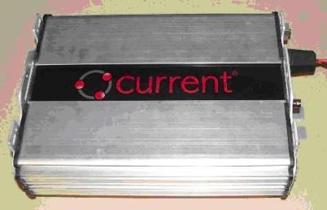
Advantages of Aluminum
Lightweight
Strong
High Strength-to-Weight Ratio
Resilient
Corrosion-Resistant
Heat Conductive
Reflective
Electrically Conductive
Non-Magnetic
The non-magnetic character of aluminum makes it particularly useful for a variety of electrical and electronic applications
Non-Sparking
Non-Combustible
Cold Strength
Fully Recyclable
2008 Honorable Mention-Engineer Products Category

Slide 30
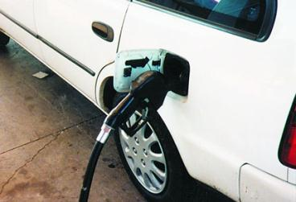
Advantages of Aluminum
Lightweight
Strong
High Strength-to-Weight Ratio
Resilient
Corrosion-Resistant
Heat Conductive
Reflective
Electrically Conductive
Non-Magnetic
Non-Sparking
Even though it is an excellent electrical conductor, aluminum does not produce sparks. This is an essential property for products used with highly flammable or explosive materials and atmospheres
Non-Combustible
Cold Strength
Fully Recyclable

Slide 31
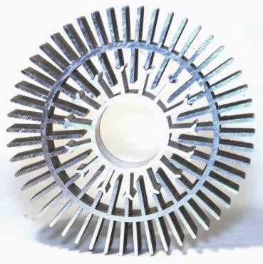
Advantages of Aluminum
Courtesy of Werner Extruded Solutions LLC
Lightweight
Strong
High Strength-to-Weight Ratio
Resilient
Corrosion-Resistant
Heat Conductive
Reflective
Electrically Conductive
Non-Magnetic
Non-Sparking
Non-Combustible
Solid aluminum does not burn or generate hazardous emissions, making it safer in applications where fire is a potential hazard
Cold Strength
Fully Recyclable
Notes:
Aluminum’s use in architectural applications takes advantage of this feature.
This photo doesn’t demonstrate the “non-combustible” nature of aluminum extrusions, but it DOES show the incredible versatility of the aluminum extrusion process!

Slide 32
Advantages of Aluminum
Photo courtesy of NASA
Lightweight
Strong
High Strength-to-Weight Ratio
Resilient
Corrosion-Resistant
Heat Conductive
Reflective
Electrically Conductive
Non-Magnetic
Non-Sparking
Non-Combustible
Cold Strength
Aluminum’s many advantages are not impaired by exposure to cold. In fact, aluminum gains strength and ductility as temperatures are reduced, making it a preferred metal for cryogenic (low-temperature) applications.
Steel and plastics get brittle when the temperature drops… Aluminum gets stronger and tougher!
Fully Recyclable
Notes:
Besides outer space and cryogenic applications, everyday products such as ladders made from aluminum extrusions take advantage of aluminum’s enhanced properties at lower temperatures.

Slide 33
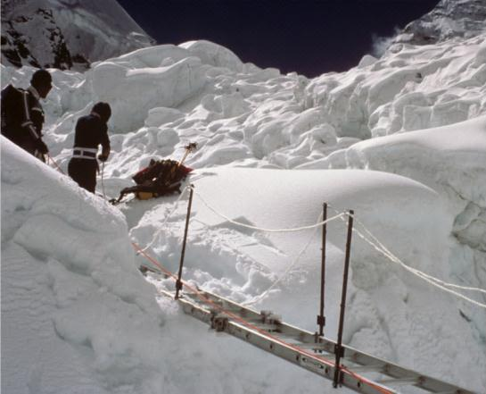
Advantages of Aluminum
Mt. Everest Climb Photo courtesy of Werner Co.
Lightweight
Strong
High Strength-to-Weight Ratio
Resilient
Corrosion-Resistant
Heat Conductive
Reflective
Electrically Conductive
Non-Magnetic
Non-Sparking
Non-Combustible
Cold Strength
Aluminum is not impaired by exposure to cold. In fact, aluminum gains strength and ductility as temperatures are reduced, making it a preferred metal for cryogenic (low-temperature) applications.
Steel and plastics get brittle when the temperature drops… Aluminum gets stronger and tougher!
Fully Recyclable
Notes:
Besides outer space and cryogenic applications, everyday products such as ladders made from aluminum extrusions take advantage of aluminum’s enhanced properties at lower temperatures.

Slide 34
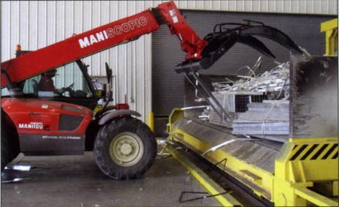
Advantages of Aluminum
Lightweight
Strong
High Strength-to-Weight Ratio
Resilient
Corrosion-Resistant
Heat Conductive
Reflective
Electrically Conductive
Non-Magnetic
Non-Sparking
Non-Combustible
Cold Strength
Fully Recyclable
Aluminum is fully, and repeatedly, recyclable, able to be recycled over and over without degradation or loss of its innate characteristics.
For products with a limited life (such as consumer durables and transportation products), aluminum’s recyclability coupled with its other outstanding attributes make it a superior material choice.
Aluminum has significant scrap value and is particularly environmentally friendly because recycling requires only 5% of the energy necessary to produce virgin aluminum.
Courtesy of Light Metal Age magazine

Slide 35
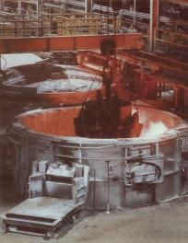
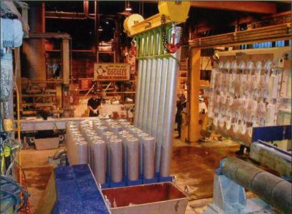
Advantages of Aluminum
Lightweight
Strong
High Strength-to-Weight Ratio
Resilient
Corrosion-Resistant
Heat Conductive
Reflective
Electrically Conductive
Non-Magnetic
Non-Sparking
Non-Combustible
Cold Strength
Fully Recyclable
Aluminum is fully, and repeatedly, recyclable, able to be recycled over and over without degradation or loss of its innate characteristics.
For products with a limited life (such as consumer durables and transportation products), aluminum’s recyclability coupled with its other outstanding attributes make it a superior material choice.
Aluminum has significant scrap value and is particularly environmentally friendly because recycling requires only 5% of the energy necessary to produce virgin aluminum.
Courtesy of Light Metal Age magazine
Notes:
Over 1 billion tons of primary aluminum has been produced since 1888: 75% of it is still in productive use! In total, recycling represents roughly 35% of global aluminum production.

Slide 36
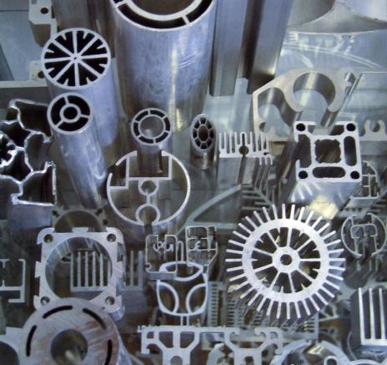
Advantages of Aluminum
Lightweight
Strong
High Strength-to-Weight Ratio
Resilient
Corrosion-Resistant
Heat Conductive
Reflective
Electrically Conductive
Non-Magnetic
Non-Sparking
Non-Combustible
Cold Strength
Fully Recyclable
Courtesy of Light Metal Age magazine
Notes:
The impressive attributes of aluminum is further enhanced when produced via the extrusion process. We’ll cover this in the next series of slides.

Slide 37
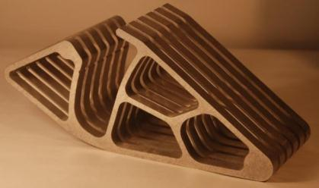
Advantages of Aluminum Extrusions
Attractive
Suitable for a wide range of finishes
Virtually seamless
Easy to fabricate
Joinable by various methods
Suitable for easy-assembly designs
Suitable for complex, integral shapes
Produced to close tolerances
Produced with uniform quality
Cost-effective
Short production lead times
Courtesy of Werner Extruded Solutions LLC

Slide 38
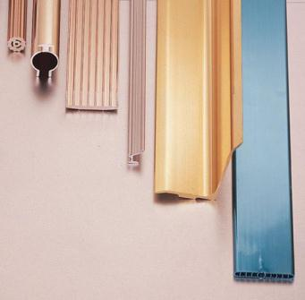
Advantages of Aluminum Extrusions
Attractive
Aluminum’s natural metallic surface is aesthetically pleasing. The natural protective oxide coating can be thickened by anodizing for extra protection, painted or powder coated for additional appearance benefits.
Suitable for a wide range of finishes
Virtually seamless
Easy to fabricate
Joinable by various methods
Suitable for easy-assembly designs
Suitable for complex, integral shapes
Produced to close tolerances
Produced with uniform quality
Cost-effective
Short production lead times

Slide 39
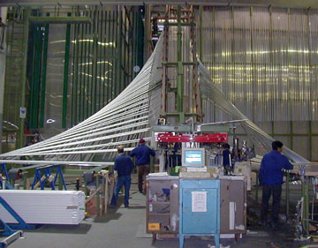
Advantages of Aluminum Extrusions
Attractive
Suitable for a wide range of finishes
Aluminum accepts a great variety of finishes, colors and textures
Virtually seamless
Easy to fabricate
Joinable by various methods
Suitable for easy-assembly designs
Suitable for complex, integral shapes
Produced to close tolerances
Produced with uniform quality
Cost-effective
Short production lead times

Slide 40
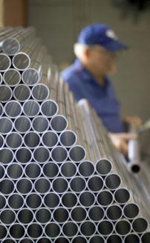
Advantages of Aluminum Extrusions
Attractive
Suitable for a wide range of finishes
Virtually seamless
Aluminum extrusions, even tubes and other hollow shapes, have no mechanically joined seams which could loosen, leak, mar appearance or reduce strength. They are one-piece products, both visually and functionally
Easy to fabricate
Joinable by various methods
Suitable for easy-assembly designs
Suitable for complex, integral shapes
Produced to close tolerances
Produced with uniform quality
Cost-effective
Short production lead times
Photo courtesy of Hydro Aluminum

Slide 41
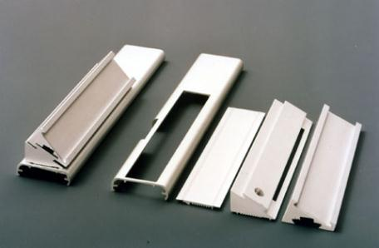
Advantages of Aluminum Extrusions
Attractive
Suitable for a wide range of finishes
Virtually seamless
Easy to fabricate
Often, designing with aluminum extrusions can eliminate many fabrication and assembly steps
Aluminum extrusions can be made with almost any cross-sectional shape. Parts can be easily cut, machines, finished, fabricated and assembled.
Joinable by various methods
Suitable for easy-assembly designs
Suitable for complex, integral shapes
Produced to close tolerances
Produced with uniform quality
Cost-effective
Short production lead times

Slide 42
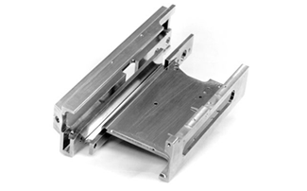
Advantages of Aluminum Extrusions
Attractive
Suitable for a wide range of finishes
Virtually seamless
Easy to fabricate
Often, designing with aluminum extrusions can eliminate many fabrication and assembly steps
Aluminum extrusions can be made with almost any cross-sectional shape. Parts can be easily cut, machines, finished, fabricated and assembled.
Joinable by various methods
Suitable for easy-assembly designs
Suitable for complex, integral shapes
Produced to close tolerances
Produced with uniform quality
Cost-effective
Short production lead times
Courtesy of Alexandria Extrusion

Slide 43
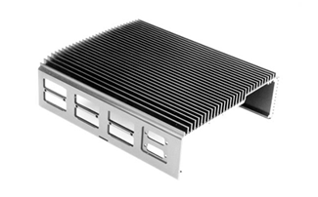
Advantages of Aluminum Extrusions
Attractive
Suitable for a wide range of finishes
Virtually seamless
Easy to fabricate
Often, designing with aluminum extrusions can eliminate many fabrication and assembly steps
Aluminum extrusions can be made with almost any cross-sectional shape. Parts can be easily cut, machines, finished, fabricated and assembled.
Joinable by various methods
Suitable for easy-assembly designs
Suitable for complex, integral shapes
Produced to close tolerances
Produced with uniform quality
Cost-effective
Short production lead times
Courtesy of Alexandria Extrusion

Slide 44
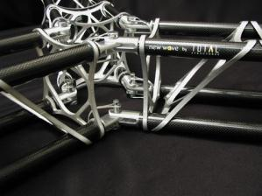
Advantages of Aluminum Extrusions
Attractive
Suitable for a wide range of finishes
Virtually seamless
Easy to fabricate
Joinable by various methods
Aluminum extrusions can be joined to other aluminum products or to different materials by all major methods, including welding, soldering, brazing, bolts, rivets, chips, adhesives, clinching and slide-on, snap-together or interlocking joints.
Suitable for easy-assembly designs
Suitable for complex, integral shapes
Produced to close tolerances
Produced with uniform quality
Cost-effective
Short production lead times
2004 Structural Category Winner
Notes:
These fascinating extrusions can be cut straight or at an angle, allowing 3D support structures to be designed efficiently and assembled very simply

Slide 45
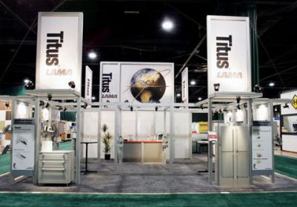
Advantages of Aluminum Extrusions
Photo courtesy of Classic Exhibits, Inc.
Attractive
Suitable for a wide range of finishes
Virtually seamless
Easy to fabricate
Joinable by various methods
Suitable for easy-assembly designs
Aluminum extrusions can be designed for easy assembly with other parts including mating surfaces or shapes that match up for easy joining.
Suitable for complex, integral shapes
Produced to close tolerances
Produced with uniform quality
Cost-effective
Short production lead times
By using aluminum extrusion’s ability to easily and cost effectively produce complex, integral profiles, designers can often accomplish tremendous part-count reductions!
Notes:
These types of tradeshow exhibits are moved from locale to locale. The light weight, ease of assembly, structural and aesthetic properties of aluminum extrusions make it a favorite!

Slide 46
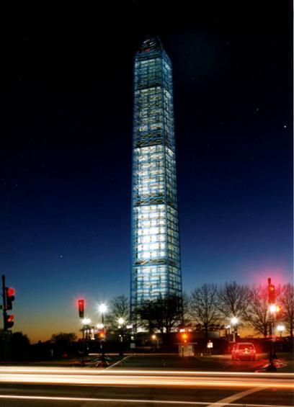
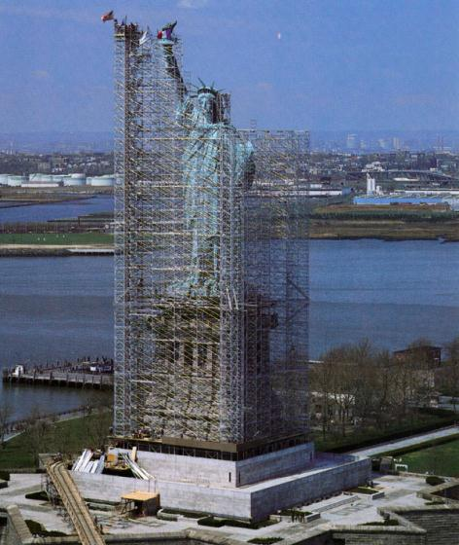
Advantages of Aluminum Extrusions
Suitable for easy-assembly designs
Notes:
Aluminum extruded scaffolding can be properly designed to span LARGE areas safely and efficiently.
Extruded aluminum scaffolding was used to clean and repair both the Washington Monument and the Statue of Liberty.

Slide 47
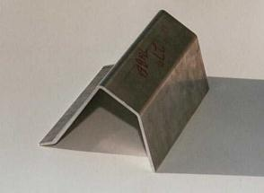
Advantages of Aluminum Extrusions
USING THE EXTRUSION PROCESS FOR NET SHAPE:
Aluminum sheet stock = 3 operations
Reduce the number of operations required
Reduce the corner stress from bending
Cosmetically more attractive
Extrusion = 1 operation
Photos courtesy of Alexandria Extrusion Company

Slide 48
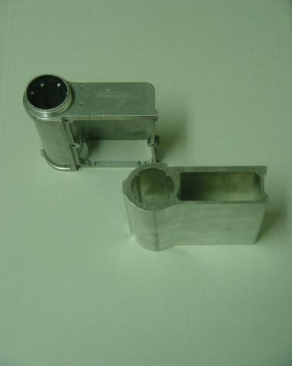
ALUMINUM EXTRUSIONS REPLACE CASTINGS
Advantages of Aluminum Extrusions
Significantly lower tooling cost
Improved strength
No porosity
Cosmetically more attractive
Shorter lead time
Photo courtesy of Alexandria Extrusion Company

Slide 49
Advantages of Aluminum Extrusions
Attractive
Suitable for a wide range of finishes
Virtually seamless
Easy to fabricate
Joinable by various methods
Suitable for easy-assembly designs
Suitable for complex, integral shapes
Shapes can combine functions that would otherwise require the production and joining of several different parts.
Produced to close tolerances
Produced with uniform quality
Cost-effective
Short production lead times
2005 Commercial/Industrial/Consumer Winner
Notes:
The cross section with integrated cooling fins can be extruded as a single piece – machining the fins into the heat sink would be an arduous, expensive process.

Slide 50
Advantages of Aluminum Extrusions
Courtesy of Werner Extrusion Solutions LLC
Attractive
Suitable for a wide range of finishes
Virtually seamless
Easy to fabricate
Joinable by various methods
Suitable for easy-assembly designs
Suitable for complex, integral shapes
Shapes can combine functions that would otherwise require the production and joining of several different parts.
Produced to close tolerances
Produced with uniform quality
Cost-effective
Short production lead times
Courtesy of Tolomatic, Inc.
Notes:
The cross section with integrated cooling fins can be extruded as a single piece – machining the fins into the heat sink would be an arduous, expensive process.

Slide 51
Advantages of Aluminum Extrusions
Courtesy of Light Metal Age magazine
Attractive
Suitable for a wide range of finishes
Virtually seamless
Easy to fabricate
Joinable by various methods
Suitable for easy-assembly designs
Suitable for complex, integral shapes
Shapes can combine functions that would otherwise require the production and joining of several different parts.
Produced to close tolerances
Produced with uniform quality
Cost-effective
Short production lead times
Notes:
Complex extrusion used for a four-axis robotic arm for use in handling and assembly operations– light, strong, incorporating MANY key features into one profile!
This is an excellent example of creativity and technology. A multi-void hollow can be a complex challenge to extruders and extrusion die makers. The many design features incorporated into this profile gives the robot manufacturer many advantages over alternative design solutions.

Slide 52
Advantages of Aluminum Extrusions
Attractive
Suitable for a wide range of finishes
Virtually seamless
Easy to fabricate
Joinable by various methods
Suitable for easy-assembly designs
Suitable for complex, integral shapes
Produced to close tolerances
Tight tolerances are routine and the ability of aluminum extruders to meet even more critical dimensions is keeping pace with advances in technology.
Produced with uniform quality
Cost-effective
Short production lead times

Slide 53
Advantages of Aluminum Extrusions
Attractive
Suitable for a wide range of finishes
Virtually seamless
Easy to fabricate
Joinable by various methods
Suitable for easy-assembly designs
Suitable for complex, integral shapes
Produced to close tolerances
Every process has its deviation from nominal
For castings, for example, it’s shrinkage and draft
For the aluminum extrusion process, dimensional tolerances are more an evolution than they are fixed
Improvements in die construction and press practices can provide for even tighter dimensional tolerances than standard on aluminum profiles
For many applications, standard aluminum extrusion dimensional tolerances have proven to be more precise than those for most competing processes
Produced with uniform quality
Cost-effective
Short production lead times

Slide 54
Advantages of Aluminum Extrusions
Attractive
Suitable for a wide range of finishes
Virtually seamless
Easy to fabricate
Joinable by various methods
Suitable for easy-assembly designs
Suitable for complex, integral shapes
Produced to close tolerances
Tight tolerances are routine and the ability of aluminum extruders to meet even more critical dimensions is keeping pace with advances in technology.
Produced with uniform quality
Cost-effective
Short production lead times
Courtesy of Werner Extruded Solutions LLC
Notes:
This part, for example, is actually TWO parts (the inner “star” with fins emanating outward from the inner tube and the outer star, with fins emanating both inward and outward from the outer tube.

Slide 55
Advantages of Aluminum Extrusions
Attractive
Suitable for a wide range of finishes
Virtually seamless
Easy to fabricate
Joinable by various methods
Suitable for easy-assembly designs
Suitable for complex, integral shapes
Produced to close tolerances
Produced with uniform quality
This reliability reduces customer costs by minimizing rejections rate, corrective fabrication and production slowdown – particularly important to the manufacturer who depends upon just-in-time (JIT) delivery.
Cost-effective
Short production lead times
Courtesy of Werner Extruded Solutions LLC

Slide 56
Advantages of Aluminum Extrusions
Attractive
Suitable for a wide range of finishes
Virtually seamless
Easy to fabricate
Joinable by various methods
Suitable for easy-assembly designs
Suitable for complex, integral shapes
Produced to close tolerances
Produced with uniform quality
Cost-effective
The boundless diversity of shapes permitted by the extrusion process cuts down or eliminates many machining—as well as joining—operations. Also, the tools required for aluminum extruding, such as dies and related items, are relatively inexpensive.
Short production lead times
Notes:
Aluminum extrusion dies often cost from $500 to $5000 depending on the size and whether the shape is a solid or hollow profile.
Comparable injection molding dies, die castings or roll forming can cost $25,000 or more.
Besides low cost, the tooling for aluminum extrusions is produced by automated die shops using wire and ram EDM, and has VERY low lead times (often a few weeks –vs- 12 - 20 weeks for comparable processes.

Slide 57
Advantages of Aluminum Extrusions
Ski-doo snowmobile circa 2001
Fabricated, welded ski mount
Ski-doo snowmobile circa 2005
Extruded aluminum ski mount
Courtesy of Werner Extrusion Solutions LLC
Notes:
Here are some photos which were taken of two well-used ski-doo snowmobiles on January 15, 2010 in Mauston, Wisconsin – built a few years apart. In the photos at the left, the ski mount is constructed of various steel pieces which have been fabricated and welded into an assembly. The more modern sled in the photos on the right shows an EXCEPTIONAL example of how the capabilities of aluminum extrusions to design features into the basic profile, without requiring unnecessary machining, joining or other work, can be done. Of course, Aluminum’s properties of getting stronger and TOUGHER in the cold also make this an ideal application. The part is lighter, stronger, easier to manufacture, and let’s face it – just plain COOLER from a design aesthetic!
This aluminum extruded ski mount is a terrific example of why aluminum extrusions are so critical to successful, modern designs!

Slide 58
Advantages of Aluminum Extrusions
Process | Typical Tooling Cost ($)
Vinyl Extrusion | $1,500 and up
Injection Molding | $25,000 and up
Die Castings | $25,000 and up
Roll Forming | $30,000 and up
Stampings | $5,000 and up
Aluminum Extrusions | $500 to $5,000
Attractive
Suitable for a wide range of finishes
Virtually seamless
Easy to fabricate
Joinable by various methods
Suitable for easy-assembly designs
Suitable for complex, integral shapes
Produced to close tolerances
Produced with uniform quality
Cost-effective
The boundless diversity of shapes permitted by the extrusion process cuts down or eliminates many machining as well as joining operations. Also, the tools required for aluminum extruding, such as dies and related items are relatively inexpensive.
Short production lead times
Notes:
Aluminum extrusion dies often cost from $500 to $5000 depending on the size and whether the shape is a solid or hollow profile.
Comparable injection molding dies, die castings or roll forming can cost $25,000 or more.
Besides low cost, the tooling for aluminum extrusions is produced by automated die shops using wire and ram EDM, and has VERY low lead times (often a few weeks –vs- 12 - 20 weeks for comparable processes.

Slide 59
Advantages of Aluminum Extrusions
Attractive
Suitable for a wide range of finishes
Virtually seamless
Easy to fabricate
Joinable by various methods
Suitable for easy-assembly designs
Suitable for complex, integral shapes
Produced to close tolerances
Produced with uniform quality
Cost-effective
Short production lead times
Notes:
Aluminum extrusion dies often cost from $500 to $5000 depending on the size and whether the shape is a solid or hollow profile.
Comparable injection molding dies, die castings or roll forming can cost $25,000 or more.
Besides low cost, the tooling for aluminum extrusions is produced by automated die shops using wire and ram EDM, and has VERY low lead times (often a few weeks –vs- 12 - 20 weeks for comparable processes.

Slide 60
Examples of Value Added Operations for aluminum extrusions:
Finishing
Painting (wet and powder)
Polish, bright dip & anodize
Mechanical Finishes
Silk screening
Fabrication
Sawing
Punching/piercing/drilling
Machining
Bending
Welding
Milling
Tumbling
Courtesy of Werner Co.

Slide 61
The Possibilities are Boundless, Limited only by the Imagination
The extrusion pictured is a theoretical shape created to illustrate some of the range of possibilities provided by aluminum extrusions
How can YOU use this flexibility to:
Spark your imagination?
Create new product concepts?
Develop improved manufacturing efficiencies?
Courtesy of Werner Co.

Slide 62
The following sequence is courtesy of Werner Co.

Slide 71
Aluminum starts as a very abundant substance, aluminum oxide. It is converted to aluminum and used in various forms throughout the world.
Notes:
Don’t spend any time on this slide. Just get across the idea that alumina is abundantly plentiful and is processed into aluminum which is used extensively.

Slide 72
The Extrusion Process
Tooling
Billet Furnace
Extrusion Press
Handling Equipment
Finish Saw
Aging System
Fabrication & Finishing
Notes:
The next series of slides will step through the actual process of aluminum extrusion, highlighting some of the critical tooling and equipment required.

Slide 73
The Extrusion Process
Tooling
Billet Furnace
Extrusion Press
Handling Equipment
Finish Saw
Aging System
Fabrication & Finishing
Notes:
We all know common ways of extruding materials.
One way is to SQUEEZE toothpaste out of a tube, creating a “solid” “ROD” of toothpaste.

Slide 74
Courtesy of Werner Extrusion Solutions LLC
Notes:
Another way is to SQUEEZE PlayDoh from a “Fun Factory” using one of many “dies” provided to make different profiles.

Slide 75
Courtesy of Werner Extrusion Solutions LLC
Notes:
The PlayDoh “Fun Factory” can even extrude HOLLOW profiles!
How do they do it???
Next slide…

Slide 76
HOW ARE HOLLOW SHAPES EXTRUDED ??
Courtesy of Werner Extrusion Solutions LLC
The PlayDoh flows through the opening between the part of the die that forms the outside diameter and the inside “mandrel” supported by two horizontal supports. The PlayDoh SEPARATES into two tube halves and “welds” back together due to the pressure needed to make it flow through the annular opening into a tube shape.

Slide 77
The Extrusion Process – Equipment overview

Slide 78
The Extrusion Process
Tooling
Billet Furnace
Extrusion Press
Handling Equipment
Finish Saw
Aging System
Fabrication & Finishing

Slide 79
The Extrusion Process
Tooling
Hollow Dies
Solid Dies
Multiple hole dies
Billet Furnace
Extrusion Press
Handling Equipment
Finish Saw
Aging System
Fabrication & Finishing
Notes:
Simple solid dies are relatively inexpensive –vs- other alternative means of making the parts (roll forming, for example). Depending on the size of the die, tooling to manufacture solid shapes can be from $300 to $1000 or more.

Slide 80
The Extrusion Process
Tooling
Hollow Dies
Solid Dies
Multiple hole dies
Billet Furnace
Extrusion Press
Handling Equipment
Finish Saw
Aging System
Fabrication & Finishing
Notes:
Hollow dies can be produced with a number of different die designs. Simpler designs can cost $1500 or more, while dies designed with replaceable inserts and other features can cost $5000 or more, but are planned for production runs approaching 1,000,000 or more lbs. (dies wear with linear ft. of extrusions produced, but often achieve 50 – 100,000 lbs of life). As with solid dies, larger tooling can cost substantially more.

Slide 81
The Extrusion Process
Tooling
Hollow Dies
Solid Dies
Multiple hole dies
Billet Furnace
Extrusion Press
Handling Equipment
Finish Saw
Aging System
Fabrication & Finishing
Courtesy of Werner Extrusion Solutions LLC
Notes:
The upper picture shows the tool steel insert which makes the “ID” of the heat sink (13 void hollow). The lower picture shows a mix of tooling for two different shapes. The back two pieces show how an aluminum ladder rung (5 hole die) is produced with the cap (left piece at back of photo) w/ replaceable inserts forming the OD of the rungs and the mandrel (right piece at back of photo) forming the ID of the rungs.
The front most die mandrel in the lower picture shows the mandrel section of a complex die which is used to produce the light weight rodless cylinder profile shown in the call out box.

Slide 82
The Extrusion Process
Tooling
Hollow Dies
Solid Dies
Multiple hole dies
Billet Furnace
Extrusion Press
Handling Equipment
Finish Saw
Aging System
Fabrication & Finishing
Notes:
Extrusion tooling is a team effort. Dies, Backers, Die Rings, Bolsters and the press components like the container, pressure plate and frame combine to properly support the tooling, which is subject to IMMENSE pressures (for a typical 2500 ton press for example, there is over 5 million lbs placed on the tooling!)
Without this proper tooling support, the die would deflect (bend), either breaking or causing the shape to run out of tolerance.
Depending on the requirements, more “form fitting” tools can be used to provide additional support and enhanced tolerances, but sometimes at an additional tooling cost.

Slide 83
The Extrusion Process
Tooling
Hollow Dies
Solid Dies
Multiple hole dies
Billet Furnace
Extrusion Press
Handling Equipment
Finish Saw
Aging System
Fabrication & Finishing
Courtesy of Extrusion Press Maintenance Manual
Notes:
The press components are carefully designed and tested to withstand extremely high forces and pressures

Slide 84
The Extrusion Process
Tooling
Hollow Dies
Solid Dies
Multiple hole dies
Billet Furnace
Extrusion Press
Handling Equipment
Finish Saw
Aging System
Fabrication & Finishing
Courtesy of Werner Extrusion Solutions LLC
Notes:
The tooling is heated in die ovens to bring it close to the temperature of the billet that will be deformed through the die. This helps to protect the tooling from thermal shock and guarantees that the process is nearly “steady state” from the first few pushes through the entire run (the tooling doesn’t vary in temperature much if properly heated).

Slide 85
The Extrusion Process
Tooling
Die Ovens
Billet Furnace
Extrusion Press
Handling Equipment
Finish Saw
Aging System
Fabrication & Finishing
Courtesy of Omav, Castool and Extrusion Pres Maintenance Manual
Notes:
The tooling can be heated with electric resistance heaters, natural gas fired ovens, infrared heat or with electrical induction. The key is the combination of energy efficiency and temperature control; different regions of the world have different relative costs of electric –vs- fuel-based heating costs.

Slide 86
The Extrusion Process
Tooling
Billet Furnace
Extrusion Press
Handling Equip.
Finish Saw
Aging System
Fabrication & Finishing
Courtesy of Omav and Extrusion Press Maintenance Manual
Courtesy of Werner Extrusion Solutions LLC
Notes:
Billets of the chosen alloy are heated from room temperature to extrusion temperature in a controlled fashion using either natural gas or electric induction. Throughout the process, the careful control of temperature is critical to ensure mechanical property performance, surface finish and tolerances.

Slide 87
The Extrusion Process
Tooling
Billet Furnace
Cutting & Shearing Logs into Billets
Extrusion Press
Handling Equip.
Finish Saw
Aging System
Fabrication & Finishing
Log Shear Photo Courtesy of Omav and Extrusion Press Maintenance Manual
Billet Saw Photo Courtesy of B&O and Extrusion Press Maintenance Manual
Notes:
The feedstock for the extrusion process starts as long length logs, which are either cut into billets and inventoried in various lengths, or cut/sheared into billets immediately before their use in the extrusion process, either cold immediately before they enter the billet/log furnace or hot, as the exit the furnace.

Slide 88
The Extrusion Process
Tooling
Billet Furnace
Extrusion Press
Handling Equipment
Finish Saw
Aging System
Fabrication & Finishing
Notes:
The extrusion press is a large horizontal cylinder (typically 30, 40, 50 or even more inches in diameter. High capacity (pressure and flow) hydraulic pumps typically provide 3000 psi or greater pressure to the cylinder.
The press has a front and a rear platen, joined by tie rods. The main cylinder pushes forward, pushing a “dummy block” through a container which holds the aluminum billet of the chosen length. The immense force (often 5 million lbs or more), pushes the billet into the die and through the die to form the profile.

Slide 89
Courtesy of Extrusion Press Maintenance Manual and RL Best
Extrusion
Notes:
The extrusion press is a large horizontal cylinder (typically 30, 40, 50 or even more inches in diameter. High capacity (pressure and flow) hydraulic pumps typically provide 3000 psi or greater pressure to the cylinder.
The press has a front and a rear platen, joined by tie rods. The main cylinder pushes forward, pushing a “dummy block” through a container which holds the aluminum billet of the chosen length. The immense force (often 5 million lbs or more), pushes the billet into the die and through the die to form the profile.

Slide 90
The Extrusion Process
Tooling
Billet Furnace
Extrusion Press
Handling Equipment
Finish Saw
Aging System
Fabrication & Finishing
Courtesy of Light Metal Age magazine
Notes:
The extrusion emerges form the front of the extrusion press, typically over 932d.F. (the solid solution temperature of one of the main alloying ingredients, “mag-silicide” (Mg2Si)

Slide 91
The Actual Extrusion Process
Tooling
Billet Furnace
Extrusion Press
Handling Equipment
Finish Saw
Aging System
Fabrication & Finishing
Courtesy of Light Metal Age magazine
Notes:
As the extrusions emerge from the press, they are grasped by a “puller” (some systems do not use a puller) which keeps slight tension on the profiles and allows the system to know precisely what length of extrusion has emerged. The system is set up to ensure that exactly the required level of scrap is taken (due to metallurgical and physical deformation reasons) and no more.

Slide 92
The Actual Extrusion Process
Tooling
Billet Furnace
Extrusion Press
Handling Equipment
Finish Saw
Aging System
Fabrication & Finishing
Courtesy of Werner Extrusion Solutions LLC
Notes:
The extrusion is cooled via ambient air, forced air fans or water quench and the “pushes” are placed onto the cooling table. (1 push can have a single hole extrusion emerging or up to 10 or more profiles for smaller shapes)
Often the extruded profiles are quite straight, but not PERFECTLY so.
The stretcher grabs each end of the extrusion and stretches the push just beyond the yield point of the material – causing it to straighten and stay straight (because it is deforming the material just PAST the yield point).
The stretched profiles are placed into batches to progress to the finish saw (the batches limit bottlenecks which would occur were the finish saw attempting to cut individual extrusions (or even individual “pushes”)

Slide 93
The Actual Extrusion Process
Tooling
Billet Furnace
Extrusion Press
Handling Equipment
Finish Saw
Aging System
Fabrication & Finishing
Courtesy of Light Metal Age magazine
Notes:
The extrusion is cooled via ambient air, forced air fans or water quench and the “pushes” are placed onto the cooling table. (1 push can have a single hole extrusion emerging or up to 10 or more profiles for smaller shapes)
Often the extruded profiles are quite straight, but not PERFECTLY so.
The stretcher grabs each end of the extrusion and stretches the push just beyond the yield point of the material – causing it to straighten and stay straight (because it is deforming the material just PAST the yield point).
The stretched profiles are placed into batches to progress to the finish saw (the batches limit bottlenecks which would occur were the finish saw attempting to cut individual extrusions (or even individual “pushes”)

Slide 94
The Actual Extrusion Process
Tooling
Billet Furnace
Extrusion Press
Handling Equipment
Finish Saw
Aging System
Fabrication & Finishing
Courtesy of Werner Extrusion Solutions LLC
Notes:
On the left of the photo you can see the runout table, with air fans overhead. The orange “puller” is keeping slight tension on the front of the “push” and alerting the controlling computer to the exact speed and length of profiles extruded.
The parts cool on the runout table and as they move to the right across the cooling table. The orange stretcher headstock awaits the next transfer of the two hole push into it. These parts will be stretched just beyond their yield point and asided to the right into batches, ready to be sawn to length.

Slide 95
The Actual Extrusion Process
Tooling
Billet Furnace
Extrusion Press
Handling Equipment
Finish Saw
Aging System
Fabrication & Finishing
Courtesy of Werner Extrusion Solutions LLC

Slide 96
Courtesy of Extrusion Press Maintenance Manual and RL Best
Notes:
This is a line drawing of an extrusion system. The handling system is drawn in an artificially short scale so that the log system, press, pullers, stretcher and finish saw are large enough to be depicted.

Slide 97
The Actual Extrusion Process
Tooling
Billet Furnace
Extrusion Press
Handling Equip.
Finish Saw
Aging System
Fabrication & Finishing
Courtesy of Werner Extrusion Solutions LLC
Notes:
At the finish saw, the saw batches are cut to the chosen length and asided into “aging racks” so that they can be artificially aged to enhance their mechanical properties.

Slide 98
The Actual Extrusion Process
Tooling
Billet Furnace
Extrusion Press
Handling Equip.
Finish Saw
Aging System
Fabrication & Finishing
Courtesy of Werner Extrusion Solutions LLC
Notes:
Here is a top view of the finish saw area, with the batches of extrusions moving under the saw to the saw gauge, ready to cut to length.

Slide 99
The Actual Extrusion Process
Tooling
Billet Furnace
Extrusion Press
Handling Equip.
Finish Saw
Aging System
Fabrication & Finishing
Courtesy of Werner Extrusion Solutions LLC
Notes:
The cut extrusions are moved into the aging rack, either manually (in this case) or automatically if the production facility is equipped with an automatic stacker.
Note the slight air spaces between the layers of extrusions – these will allow this plant’s side flow ovens to pass heated air evenly between the layers, avoiding hot or cold spots and enhancing temperature uniformity and thus material properties.

Slide 100
The Actual Extrusion Process
Tooling
Billet Furnace
Extrusion Press
Handling Equip.
Finish Saw
Aging System
Fabrication & Finishing
Courtesy of Werner Extrusion Solutions LLC
Notes:
Aging is typically done at lower temperatures (a typical cycle is 350 degrees for 8 hours for many common alloys). The process allows the mag-silicide to come out of solution in a controlled manner.
“Artificial aging” enhances what would be possible naturally through time, by providing a slightly harder extrusion in perhaps 8 hours –vs- the many, many months that would be required for the extrusion to “naturally age”

Slide 101
The Actual Extrusion Process
Tooling
Billet Furnace
Extrusion Press
Handling Equipment
Finish Saw
Aging System
Fabrication & Finishing
Courtesy of Werner Extrusion Solutions LLC
Notes:
Aluminum extrusions allow for complex integral shapes, easily and inexpensively incorporating many features into one extruded part –vs- requiring subsequent fabrication and/or assembly. Further fabrication and assembly is, however, also easy and efficient to accomplish, as is surface finishing to achieve different colors, textures or other surfaces results – this can be done through painting, anodizing and chemically or mechanically finishing the extrusions.

Slide 102
The Actual Extrusion Process
Fabrication & Finishing: Anodizing
Extrusions are racked either horizontally or vertically. Electrical contact with profiles is critical.
Courtesy Mid-States Aluminum Corp.
Notes:
The aged extrusions can be used as lineals, or can be coated or fabricated as needed.
This photos shows cut extrusions racked and fastened to anodizing racks; note the clamps providing excellent contact to allow the electro/chemical anodizing process to proceed in a controlled fashion for all parts.

Slide 103
The Actual Extrusion Process
Fabrication & Finishing: Anodizing
Racked extrusions are moved into a series of etching, anodizing and other tanks by crane.
Courtesy Mid-States Aluminum Corp.

Slide 104
The Actual Extrusion Process
Fabrication & Finishing: Anodizing

Slide 105
What Is Anodizing?
Anodizing is an electrochemical process that converts the aluminum surface into a decorative, durable, corrosion-resistant, anodic aluminum oxide finish.
Courtesy of PFOnline.com
Notes:
This slide illustrates the anodic layer created in the anodizing process.

Slide 106
What Can Anodizing Do for Aluminum?
The Anodic Oxide Finish Enhances:
Wear resistance
Lubricity
Electrical properties
Heat management
Corrosion resistance
Aesthetics
Bonding
Notes:
Anodizing makes aluminum better.

Slide 107
What Can Anodizing Do for Aluminum?
It provides attractive, minimum-maintenance, highly durable exteriors, roofs, curtain walls, ceilings, floors, escalators, lobbies, and staircases in skyscrapers and commercial buildings throughout the world.
It has revolutionized the construction of computer hardware, exhibit displays for trade shows, scientific instruments, and a constantly expanding array of home appliances, consumer products, and building materials.
It is environmentally safe, producing few, if any, harmful effects on land, air or water.

Slide 108
The Anodic Oxide
The anodic oxide structure originates from the aluminum
substrate and is composed only of aluminum oxide.
Total finish thickness, pore diameter and cell wall thickness
range in size depending upon process parameters.
The anodic oxide is integrated with the underlying aluminum
for total bonding resulting in a finish with no filiform corrosion
and unmatched adhesion.
Outer layer
Pore
Interface
Base material
Notes:
This slide demonstrates the buildup of coating that occurs in the anodizing process

Slide 109
The Anodic Oxide
The anodic oxide is integrated with the aluminum substrate, and has a highly ordered, porous structure that allows for secondary processes, e.g., organic and inorganic coloring, and a variety of seals that enhance its end use.
Photo courtesy of FEM, Schwäbisch Gmünd, Germany
Notes:
A common misconception is that anodizing is applied on the surface of the aluminum like a paint. Anodizing actually grows from the base metal.

Slide 110
Benefits of the Anodic Oxide
Durability. Most anodized products have an extremely long life span and offer significant economic advantages through maintenance and operating savings.
Color Stability. Exterior anodic coatings provide good stability to ultraviolet rays, do not chip or peel, and are easily repeatable.
The unique dielectric properties of an anodized finish offer many opportunities for electrical applications.
Photos courtesy of the Aluminum Anodizers Council

Slide 111
Benefits of Anodizing
Ease of Maintenance. Scars and wear from general use (fabrication, handling, installation, frequent surface cleaning) are virtually nonexistent. Rinsing or mild soap-and-water cleaning usually will restore an anodized surface to its original appearance. Mild abrasive cleaners can be used for more difficult deposits.
Aesthetics. Anodizing offers a large and increasing number of gloss and color alternatives, and minimizes or eliminates color variations. Unlike other finishes, anodizing allows the aluminum to maintain its metallic appearance.

Slide 112
Benefits of Anodizing
Cost. A lower initial finishing cost combines with lower maintenance costs for greater long-term value.
Health and Safety:
Anodizing is a safe process that is not harmful to human health. An anodized finish is chemically stable, will not decompose, is nontoxic, and is heat-resistant to the melting point of aluminum (1,221°F).
Since the anodizing process is an enhancement of a naturally occurring oxidation process, it is non-hazardous and produces no harmful or dangerous by-products.
The anodic oxide is recyclable with the aluminum substrate.

Slide 113
Common Anodic Oxide Types
Hard Anodizing (or Type III anodizing) is a term used to describe the production of anodic oxides characterized by high hardness and abrasion resistance. They are produced using special anodizing conditions (very low temperature, high current density).
Conventional Anodizing (or Type II anodizing) increases the decorative corrosion resistance of the aluminum component. It can be dyed to produce many beautiful colors and printed with graphics and photo images. They are produced at room temperature and lower current density.
Notes:
Hard Anodizing and Bright Dipping are 2 different anodizing processes that produce specific characteristics. These resulting characteristics (hardness and brightness) are examples of the versatility of anodizing.

Slide 114
Common Applications for Anodizing
Structures and architectural categories of all types
Commercial and residential building products
Motor vehicle components

Slide 115
Common Applications for Anodizing
Appliances
Food preparation equipment
Furniture
Sporting goods and boats
Photo courtesy of Sylvan Sport

Slide 116
Fabrication & Finishing: Painting
Extrusions are typically painted in either horizontal or vertical paint lines, using either liquid paint or powder coat.
Notes:
Extrusions can also be coated with liquid or powder paint to add color and additional surface attributes to the lineal or fabricated extrusions

Slide 117
Why Coat Extruded Aluminum?
Cosmetic Function:
Control the Appearance
Color Coordination
Visual Uniformity
Protective Function:
Guard the Substrate
from Environmental Damage
Acid Rain, other Pollutants
Salt Spray
from Excess Oxidation
Photos courtesy of Bill Hanusik/Akso Nobel

Slide 118
Why Coat Extruded Aluminum?
Coated Aluminum Extrusions are used in a variety of end uses
Building Products
Commercial Windows
Curtain Wall
Column covers
Residential Windows
Transportation
RV and Bus windows
Windshield frames
Specialty
Sports Equipment
Solar Panels
Courtesy of PPG Coil & Extrusion Coatings

Slide 119
Versatility of Coatings
Range of Resin Chemistries
Grades of Performance Properties (fading/warranty)
Visual Finishes
Costs
Courtesy of Bill Hanusik and Akzo Nobel
Notes:
The top photo shows just a few of the bold colors available.
Different coatings can perform dramatically differently – one might last for 1 year without fading and have a 5 year warranty, while another might last 10 years with a 20 year warranty!

Slide 120
Fabrication & Finishing: Painting
A wide variety of colors are possible.
Notes:
This photo shows extruded lineals emerging from a vertical paint line.
120

Slide 121
Liquid Paint and Powder Coat
Cleaning and Pretreatment
Electrostatic Spray Application
Cure
Notes:
Cleaning and pretreatment ensure good adhesion to the substrate and contribute to a uniform surface finish.
Electrostatic application is the most efficient means of getting the coating onto the profile by means of electrostatic charge; it has no effect on the quality of the coating material.
Paint cure is achieved by baking the coating profile for a specified time at a specified temperature.

Slide 122
Formulations Based on Resin Type
Polyester
Acrylic
Modified Polyester
Fluoropolymer
Notes:
These resin types are common to both liquid and powder coatings.

Slide 123
Comparing Liquid and Powder Coatings
LIQUID
Brighter “Metallic” Colors
Smoother Finish
Salt-Spray Resistance (e.g., Seacoast)
Proven History (mature technology)
POWDER
No Volatile Organic Compounds (VOCs)
Harder Finish
Fabrication might require less Touch-up
Overspray can be Reclaimed
Notes:
Desired performance and environment of use determine which finishing options to choose.

Slide 124
Comparing Liquid and Powder Coatings
Liquid Coatings offer more metallic choices than powder
Powder coatings are available in a wide range of solid and mica pigment effects.
Silver metallic finishes are the preferred choice for curtainwall applications.
Silver mica’s are a good design choice in powder
Powder Coatings exhibit superior hardness in use. They have long been used for applications like motor cycle frames, lawn mowers, mountain bikes and appliances for a hard finish
Powder Coatings show an advantage in use in areas where architectural metal is exposed to abrasion like storefronts and entry doors.
Notes:
Desired performance and environment of use determine which finishing options to choose.

Slide 125
Comparing Liquid and Powder Coatings
Courtesy of AIA
Notes:
Desired performance and environment of use determine which finishing options to choose.

Slide 126
Environmental Considerations
Powder Coatings contain no VOC’s
VOC’s can be burned with liquid coatings, but require energy and emit CO2.
Powder Coatings use less energyin transportation
Liquid Coatings may be advantageous from an environmental perspective in certain environments.

Slide 127
AAMA Market Segments
Courtesy of AIA

Slide 128
Examples of Coatings
34 Story, Midtown Towers IV Lofts, Miami, FL. Windows, Sliding Glass Doors and Railings.
Liquid Paint
Ritz Carlton, Grand Cayman, extruded railings, awnings, windows and doors.
Powder Coat
Notes:
Desired performance and environment of use determine which finishing options to choose.

Slide 129
Courtesy of AIA

Slide 130
Examples of Coatings
Courtesy of AIA
AOL Timer Warner Building, Manhattan, New York, Extruded aluminum louvers, windows and doors. Powder Coat
Naples Florida Municipal Parking Garage, Extruded aluminum sun screens and decorative railings.
Powder Coat
Notes:
Desired performance and environment of use determine which finishing options to choose.

Slide 132
Some Limitations of the Aluminum Extrusion Process
Circle Size
The circumscribing circle that the profile could fit through
Wt/Ft
Too heavy? Too light?
Shape Constraints
High tongue ratios
Somewhat balanced wall thicknesses
Other
Notes:
While the aluminum extrusion process is incredibly versatile, it does have its limitations.
Circle size: the larger the profile’s circle size, the larger the billet diameter required, and the larger the press required to “push” the larger billet. Increasing press size leads to higher costs and fewer presses available once the profile gets too large in diameter.
Wt/Ft: Profiles which are extraordinarily heavy require larger presses, and extrusions with exceedingly thin walls, and thus often very light, can be pushed, but require high unit pressures (larger capacity presses but often acting on smaller diameter billets).
Tongue Ratios: The air space between portions of an extrusion can be produced by “tongues” on the die. If the based of the “tongue” is too thin –vs- the area of the tongue, there often isn’t sufficient support on the tongue and it may break, ruining the die.
Wall Thickness Balance: Profiles with a combination of extremely heavy portions and extremely light/thin walls are often difficult to produced.

Slide 133
Some Limitations of the Aluminum Extrusion Process
 | Circumscribed Circle Size in inches |  |  |  |  | Corresponding Profile weight (lbs/ft)
Cross Section Area in sq inches | <1 | 1 to 7 | 7 to 10 | 10 to 14 | >14 | Min | Max
<.050 | L | x | x | x | x | - | 0.06
.050 to .100 | G | G | L | x | x | 0.06 | 0.12
.100 to 1.0 | W | W | L | x | x | 0.12 | 1.18
1.0 to 2.5 | x | W | W | L | x | 1.18 | 2.94
2.5 to 10 | x | W | W | G | L | 2.94 | 11.76
>10 | x | x | W | G | L | 11.76 | -
 | x | Not available
 | L | Limited Availability
 | G | Generally Available
 | W | Widely Available
 | NOTE:
 | There are many presses available with up to 7" diameter containers
 | There are fewer presses available with 7" to 10" diameter containers
 | There are even fewer presses available with 10" to 14" diameter containers
 | There are very few presses available with greater than 14" diameter containers
Notes:
Extruded profiles can take on a wide variety of shapes and sizes. Often, the limit to what a particular extrusion press can produce is controlled by the “circumscribing circle” (and often related cross sectional area or weight/ft) that can be handled.
For example, an extrusion press set up and sized to handle 8” diameter billets, can produce most profiles close to 8” in diameter (sometimes even slightly more, perhaps 9”, if a “feeder” system is used to spread the billet into a larger die diameter).
There are many presses capable of handling 7” billets, fewer between 7 and 10”, even fewer between 10” and 14” and very few capable of handling over 14” diameters.

Slide 134
Examples of Aluminum Extrusions Difficult Tongue Ratio
Courtesy of Hydro Aluminum and Werner Extrusion Solutions LLC
Notes:
This is a complex heat sink extrusion with VERY high, and thus difficult, tongue ratios – picture the extrusion die which is forming the “slot” between the fins, and realize that it has a VERY narrow support area (between the tips of the fins) –vs- the area of the void – this area must hold back aluminum billet, only allowing it to flow between the “tongue” openings.
Profiles like this can be very difficult to run (but obviously not impossible – this supplier makes many thousands of lbs. of this profile each month!)

Slide 135
Examples of Aluminum Extrusions
Courtesy of Werner Co.
Notes:
There are many, many design capabilities and recommendations for designing profiles, parts, assemblies and final products from aluminum extrusions.
Visit the Aluminum Extruders website – aec.org for more detailed design assistance and suggestions.

Slide 136
Examples of Aluminum Extrusions
Courtesy of Hydro Aluminum and Werner Extrusion Solutions LLC
Notes:
The following slides show some of the great variety of aluminum extrusions and products made from them that exist.
The primary author of this PowerPoint worked for a company which had approximately 10 extrusion presses, and made nearly 100,000 different shapes over the decades.

Slide 137
Fabrication of Aluminum Extrusions
Courtesy of FOM USA
While standard cutting, drilling, tapping, milling and other machining operations can be done effectively on aluminum extrusions, there are custom machines designed to optimally fabricate both large and small shapes, in both short and long sizes
Notes:
The following slides show some of the great variety of aluminum extrusions and products made from them that exist.
The primary author of this PowerPoint worked for a company which had approximately 10 extrusion presses, and made nearly 100,000 different shapes over the decades.

Slide 138
Fabrication of Aluminum Extrusions
Courtesy of FOM USA
Notes:
The following slides show some of the great variety of aluminum extrusions and products made from them that exist.
The primary author of this PowerPoint worked for a company which had approximately 10 extrusion presses, and made nearly 100,000 different shapes over the decades.

Slide 139
Fabrication of Aluminum Extrusions
Courtesy of FOM USA
Notes:
The following slides show some of the great variety of aluminum extrusions and products made from them that exist.
The primary author of this PowerPoint worked for a company which had approximately 10 extrusion presses, and made nearly 100,000 different shapes over the decades.

Slide 140
Fabrication of Aluminum Extrusions
Courtesy of FOM USA
Notes:
The following slides show some of the great variety of aluminum extrusions and products made from them that exist.
The primary author of this PowerPoint worked for a company which had approximately 10 extrusion presses, and made nearly 100,000 different shapes over the decades.

Slide 141
Examples of Aluminum Extrusions Modular assembly
Notes:
Here are some typical extruded profiles showing the tremendous ability to “put metal where you need it” and to design in features directly extruded –vs- trying to fabricate or fasten these types of features to other materials.
These type of shapes are commonly used to construct easy-to-assemble structures, tables, fixtures, machining centers, etc…

Slide 142
Polyamide
Insulating Struts
30 year old method of thermally breaking aluminum fenestration products.
Allows for separating an aluminum profile into two parts to reduce thermal conductivity within a window or door system.
The three step assembly process includes knurling of the aluminum pocket, insertion of the strut, and crimping the assembly to create a structural, mechanical bond.
Design/drawing courtesy of Gastadello Sistemi
Notes:
These architectural applications show some examples of window systems utilizing the ability of aluminum extrusions to integrate many features into a single extrusion.
142

Slide 143
Design/drawing courtesy of www.gastadellosistemi.it

Slide 144
Examples of Aluminum Extrusions
Building-Integrated Photovoltaic insulating glass modules framed in extruded aluminum
Photos courtesy of Schüco International KG
Notes:
Aluminum extrusions (often anodized or painted) are used throughout the world for exquisite architectural designs.
The extrusions used in this skylight system incorporate building-integrated photovoltaic (BIPV) insulating glass modules.
The system also uses an extruded aluminum vertical façade structurally supported by aluminum extrusions, which seamlessly combines with the BIPV panels for a dramatic and breathtaking effect.
The fully-integrated system uses strong, load-bearing aluminum extrusions to construct a skylight/atrium envelope that saves and generates energy, while enhancing building design.

Slide 145
Examples of Aluminum Extrusions
Courtesy of Light Metal Age magazine
Notes:
Aluminum extrusions (often anodized or painted) are used throughout the world for exquisite architectural designs.

Slide 146
Examples of Aluminum Extrusions
Courtesy of Light Metal Age magazine
Notes:
Aluminum extrusions (often anodized or painted) are used throughout the world for exquisite architectural designs.

Slide 147
Telecommunications Industry
Examples of Aluminum Extrusions
Extruded from 6061 alloy
Machined in a 5 axis CNC fixture
Straightlined mechanical finish applied
No anodic coating applied

Slide 148
Electronics Industry
Examples of Aluminum Extrusions
Extruded from 6063
T5 Temper
Heat dissipation enclosure – transferring thermal energy from a high temperature object to a 2nd object of a lower temperature
Machined in a multi-axis CNC machining center
Clear sulfuric anodize finish

Slide 149
Defense Industry
Examples of Aluminum Extrusions
Extruded from 6061 alloy
T6 Temper
Machined in a 4th-axis CNC fixture
ExtremEtch™ matte finish – minimal reflectivity in comparison to Alkaline etch
Mil Spec Type III hardcoat – black

Slide 150
2014 International Aluminum Extrusion Design Competition
www.etfoundation.org
www.aec.org
Design, Architect, and Engineering Students:
Apply what you've learned about design and engineering by entering the International Aluminum Extrusion Design Competition. It's an excellent opportunity for a hands-on learning experience with the potential for professional recognition and earned scholarships.
Student Class Scholarship Awards
Enter the competition to receive the recognition you so richly deserve; gain pride and a sense of accomplishment. And, of course, there are the scholarships totaling $8,500!
Student Class Scholarships:
1st place $3000
2nd place $2000
3rd place $1000
Sapa Sustainable Design: $2,500
Sapa Extrusions North America is the
Exclusive Platinum sponsor of the 2014 Design Competition
Notes:
Here is some information about the annual aluminum extrusion design competition. So far almost $200,000 have been given as cash prizes!

Slide 151
Sustainable Design Award
Promotes aluminum’s “green” advantages
Will be presented to the student entry that
Meets the four basic judging criteria: creativity, practicality, process improvement, and market potential
Best addresses societal and/or environmental concerns
Is a viable extrusion-based product that meets the demands of the environment while contributing to the quality of life for its intended users.
Examples :
A device that helps a third world farmer increase crop yields with less labor
An item that facilitates daily living for the handicapped or elderly

Slide 152
Past Design Competition Winners and Honorable Mentions
2014 Sustainable Design Winner

Slide 153
Past Design Competition Winners and Honorable Mentions
2014 First Place Winner

Slide 154
Past Design Competition Winners and Honorable Mentions
2014 Second Place Winner

Slide 155
Past Design Competition Winners and Honorable Mentions
2013 First Place Winner

Slide 156
Past Design Competition Winners and Honorable Mentions
2013 Sustainable Design Award

Slide 157
Past Design Competition Winners and Honorable Mentions
2012 First Place Winner
This extruded aluminum stretcher is designed to transport injury victims.
The MedStretch extruded aluminum stretcher is lightweight and mobile for transporting injury victims. The compact stretcher design unfolds, sets up quickly and stores easily.

Slide 158
Past Design Competition Winners and Honorable Mentions
2012 Sustainable Design Award

Slide 159
Past Design Competition Winners and Honorable Mentions
2011 Sustainable Design Award Co-winner
Evaporative Cooling Device
VAPOR is a portable cooling canister based on the pot-in-pot system commonly used in Northern Africa. The VAPOR is an elegantly simple device that keeps food items cool by using evaporative cooling.

Slide 160
Past Design Competition Winners and Honorable Mentions
2011 Sustainable Design Award Co-winner
Hydroponic Gardening System
This urban gardening solution provides a cost-effective method for growing fresh vegetables in areas where land for traditional gardens is not available, such as driveways, rooftops, porches, and basements. The single–extrusion design accommodates cavities for water, sand, nutrient solution, filter media, and a heating element and takes full advantage of the ability to build in functionality and even takes advantage of aluminum’s heat transfer capabilities.

Slide 161
Past Design Competition Winners and Honorable Mentions
2010 Grand Prize
Hanging LED Light Fixture
EXCELLENT STUDENT ENTRY EXAMPLE
The 2010 Grand Prize was awarded to a student entry. The Grand Prize is only awarded in combined Student & Professional competition years.
“LED light fixtures must properly dissipate heat generated by LEDs to ensure high efficiency and long life. “Integrated designs can include heatsink fins, slots, optical cavities, mounting rails, screw bosses—all necessary for LED fixtures. Increased design integration reduces part count and cost,” noted the designer. “Also, smooth extrusions need little to no finishing to make thermal interfaces, unlike die casting which must be machined and results in a higher cost."

Slide 162
Past Design Competition Winners and Honorable Mentions
2010 Sustainable Design Award
Innovative water filtration/purification system uses extruded aluminum to exploit many of the design possibilities that the aluminum extrusion process provides. A single profile is used to form both halves of the main compartment and integrates filter guides in the extrusion design so that minimal post-extrusion fabrication is needed.

Slide 163
www.ETFdesign.org
Aluminum Extrusion Design Competition
Website contains contest information, design resources, and more.
Download the Call for Entries, including Entry Form from the website
Entries are due March 30, 2015
(see Entry Form for details)
General Aluminum Extrusion information and resources: www.AEC.org
Notes:
Thanks for your attention.
Here is the contact information for the design competition – we’re looking forward to reviewing your entries!

Slide 164
List of LINKS
Aluminum Association – www.aluminum.org
The European Aluminium Association – www.eaa.net
The International Aluminium Institute – www.world-aluminium.org
German Aluminium Association (GDA) - www.aluinfo.de/
The Aluminum Anodizer’s Council – www.anodizing.org
The American Architectural Manufacturers Assoc. –www.aamanet.org

Slide 165
Other Useful Publications from the Aluminum Association
Aluminum standards and data
This reference contains: nominal and specified chemical compositions of alloys; typical mechanical and physical properties of commonly used commercial alloys; mechanical property limits; information on comparative characteristics and applications; definitions, and dimensional tolerances for semi-fabricated products. The new 2009 edition contains the latest information from the 2009 American National Standards for wrought aluminum and aluminum alloys. In addition, the Terminology Section has been reorganized and harmonized with international definitions. All of this is included in a convenient format, in either print or CD versions. The publication is available in both metric and US customary units.
Available at: http://www.aluminum.org/Content/NavigationMenu/BookStore/WhatsNew1/default.htm (also available by calling 301-645-0756).
Teal Sheets - International Alloy Designations and Chemical Composition Limits for Wrought Aluminum and Wrought Aluminum Alloys Revised for 2009, with information on 23 new alloy designations, their associated chemical composition limits and nominal densities. This registration record is the defining source for the designations and chemical composition limits for wrought aluminum and wrought aluminum alloys referenced in a number of standards and specifications worldwide. It contains close to 500 designations, chemical composition limits and nominal densities for wrought aluminum and wrought aluminum alloys registered with The Aluminum Association internationally. Other information includes a list of previously registered - but currently inactive - alloy designations, the Declaration of Accord on an International Designation System for Wrought Aluminum and Wrought Aluminum Alloys and a list of the Signatories to the Accord.
Available on line at: www.aluminum.org/tealsheets

Slide 166
Other Useful Publications from the Aluminum Association
Yellow Sheets - Tempers for Aluminum and Aluminum Alloy Products
This publication provides a listing of the alloy/temper products that are not included in the AA publication Aluminum standards and data, which is described above. It also contains a listing of deactivated alloy/temper products and provides information on the procedures for registering new alloy/product tempers. There is also a metric companion document known as the “Tan Sheets”.
Available at the Bookstore at: www.aluminum.org or a direct link at: http://www.aluminum.org/source/Orders/index.cfm?section=BookStore&ETask=1&Task=1&SEARCH_TYPE=FIND&FindIn=0&FindSpec=Yellow&x=17&y=10 (also available by calling 301-645-0756)
Guidelines for Minimizing Water Staining of Aluminum
This publication is available from the Aluminum Association’s Sheet & Plate Division as a free download at: http://www.aluminum.org/Content/NavigationMenu/TheIndustry/SheetPlate/GuidelinesforMinimizingWaterStainingofAluminum2009/TR309.pdf
Aluminum Applications in the Rail Industry
http://www.aluminum.org/Content/NavigationMenu/TheIndustry/SheetPlate/AluminumApplicationsintheRailIndustry/Aluminum_Applications_in_the_Rail_Industry.pdf
The article above is available as free download at: http://www.aluminum.org/Content/NavigationMenu/TheIndustry/SheetPlate/default.htm

Slide 167
Courtesy of Light Metal Age magazine
More Info @ AEC.ORG
Notes:
You can always go to “AEC.ORG” for more information!

Slide 168
Sample Quiz Q&A’s
QUESTION | ANSWER | QUESTION | ANSWER
Are aluminum extrusions limited to simple standard shapes or are complex integral shapes possible? | Complex shapes are possible and easily done | It is necessary to chemically treat aluminum to create a protective oxide coating? | No
As aluminum is subjected to colder temperature it gets (circle those that apply): | Tougher, brittle, stronger, more ductile, smaller | Hollows can only be created in aluminum extrusions by subsequently drilling or otherwise creating the voids? | No
It is always easier to extrude simple shapes and then subsequently fabricate and assembly complex features than to incorporate this into the extrusion design? | No | Can aluminum be welded or brazed? | Yes
Are aluminum extrusion tooling costs generally lower than competitive manufacturing processes? | Yes | Lead times for aluminum extrusion tooling is often in excess of 5 weeks? | No
What is the most common alloy series used for aluminum extrusions? | 6xxx series (Mg-Si-based) | Is anodizing applied like liquid paint? | No
Aluminum is about _ % as heavy as iron, steel, copper and brass? | 33% | Can aluminum be powder painted? | Yes
What types of ultimate tensile stresses are possible for appropriately alloyed and heat treated aluminum? | 80,000 – 90,000 psi | Aluminum extrusions can only be generally made in small sizes that would fit within a 5 inch circumscribing circle? | No
Is aluminum generally corrosion resistant? | Yes | On an equal weight basis, can aluminum be twice as conductive as copper? | Yes
Does aluminum conduct heat better than other common metals on both a weight and cost basis? | Yes | Aluminum is magnetic? | No
Properly produced and treated, what % reflectivity is possible with aluminum? | 80% | Aluminum by nature is non-sparking? | Yes
Volume for volume, aluminum is less than 50% as electrically conductive as copper? | No – it is 62%! | Will solid aluminum support combustion? | No
Notes:
In case the professors want to have some sample quiz questions available…

